Slide 1
The Internet of Things
What’s that?

Slide 2
The IoT
“The Internet of Things (IoT), also called Internet of Everything is the network of physical objects or "things" embedded with electronics, software, sensors, and connectivity to enable objects to exchange data with the production, operator and/or other connected devices”

Slide 3
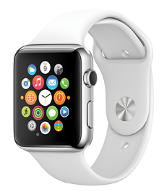
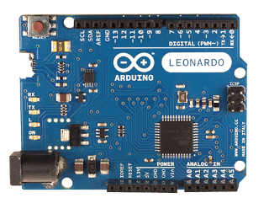
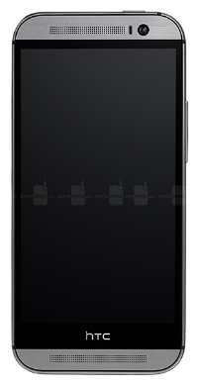
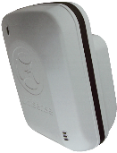
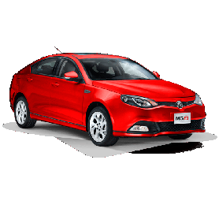



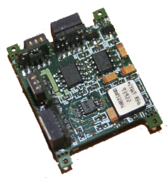
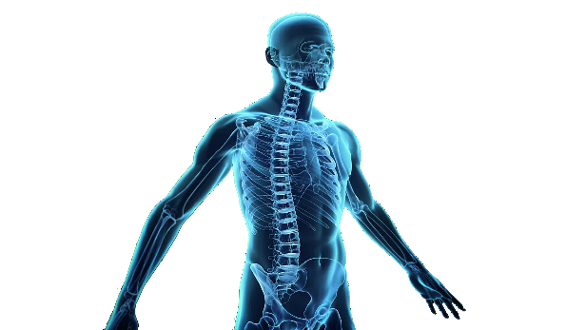
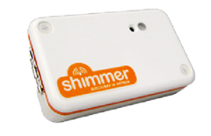
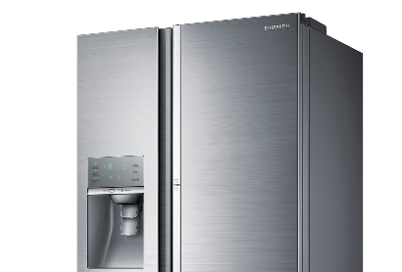
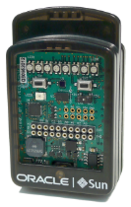
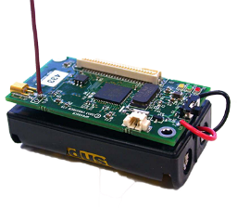


Slide 4
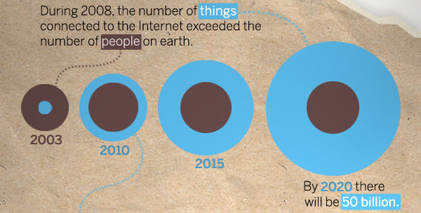
Growth of the IoT

Slide 5
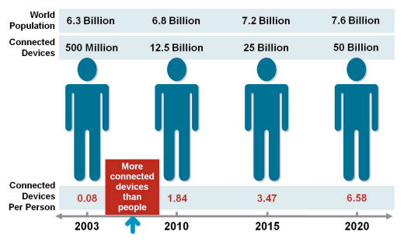
IoT was born.....
Cisco Define the IoT as born circa 2008-09
...as the number of things surpassed people on the internet

Slide 6
Anytime, anywhere, anything
Anytime
Anywhere
Anything

Slide 7
Why should I Study this?
A massive growth area
This will shape the future of humanity
How we live will change under these forces
We finally brign us into the age of ubquitous computing
Computing devices saturated into the environment
Perfectly integrated into our lives
It would be nice to be part of building the future right?

Slide 8
Money
“The IoT has a total potential economic impact of $3.9 trillion to $11.1 trillion a year by 2025. At the top end, that level of value [...] be equivalent to about 11 percent of the world economy”
– Mc Kinsey Global Institute, June 2015

Slide 9
IoT Applications Or why should I care? what will it do for me?

Slide 10
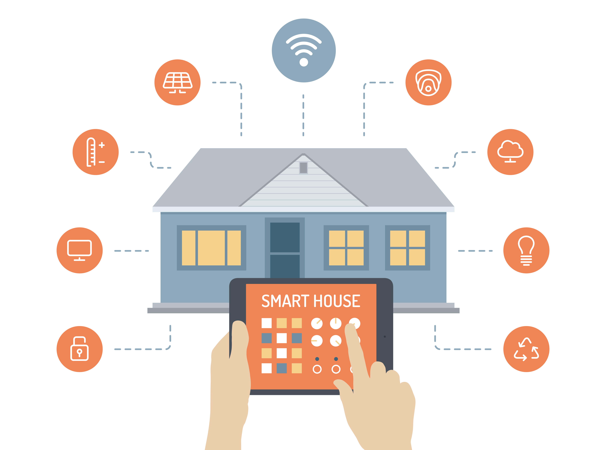

Slide 11


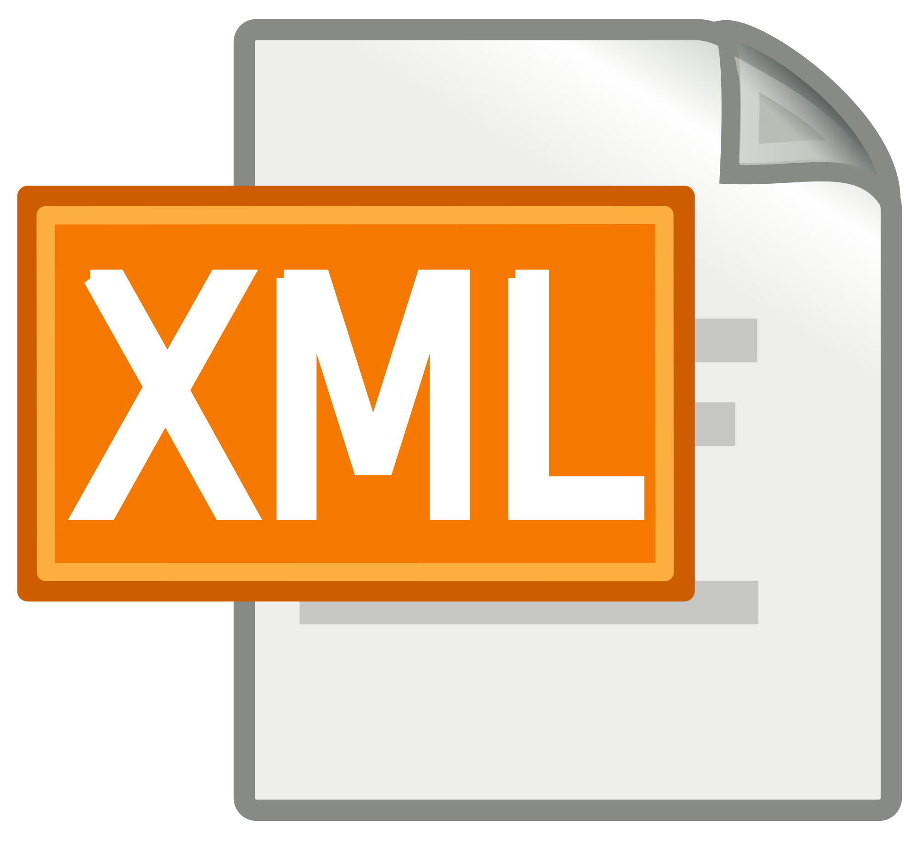




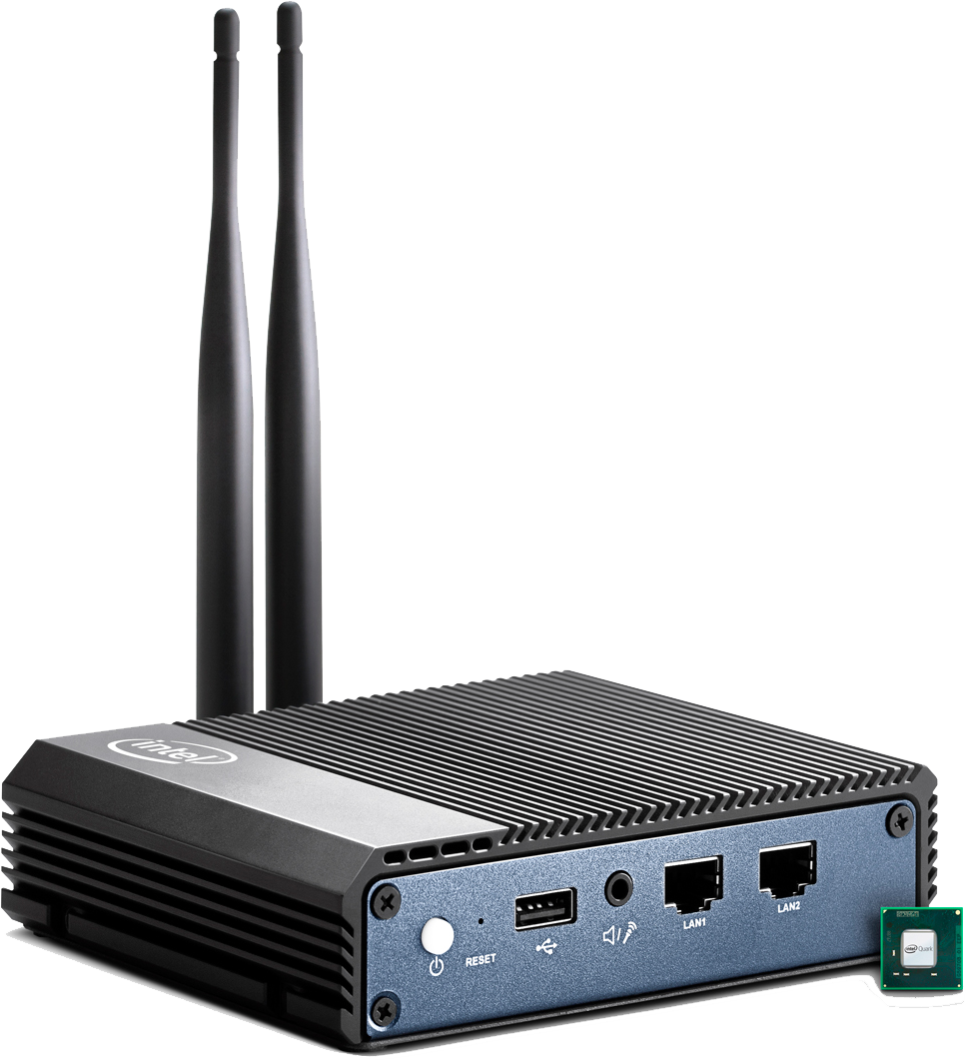

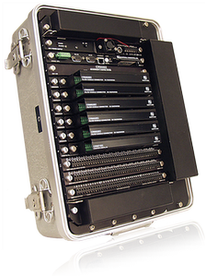

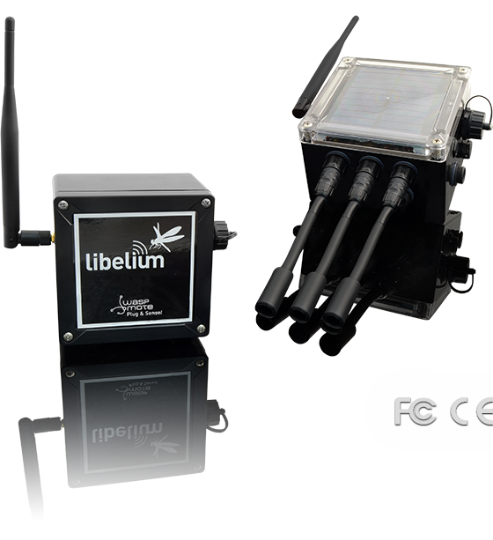
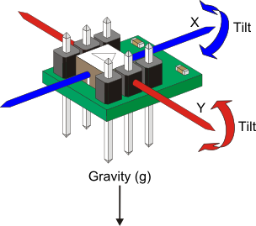
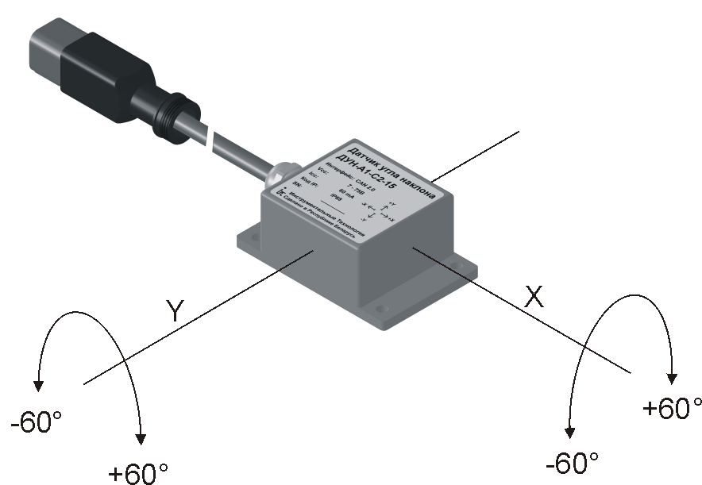
Data Access
Cloud
Gateway
Sensor

Slide 12
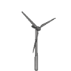



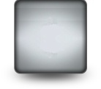

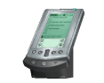




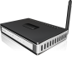


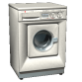



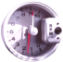
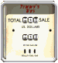
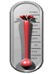

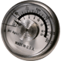
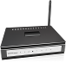
M2M Application #1 Smart metering
Wind Turbine
Home displays
TV, Computer
Data Center
Solar Panel
In-Home
Energy
Display
Wan
Communication
Light
Meters Coms
Appliances
Temperature
Breaker
Valves
Smart
Water
Smart
Gas
Smart Elec.
Gateway

Slide 13
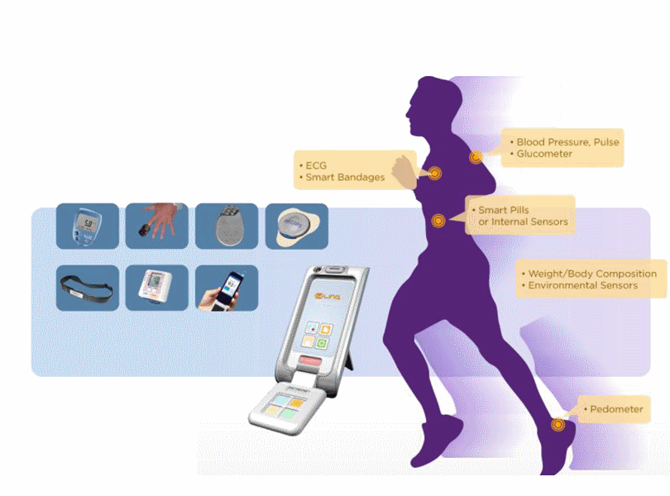
M2M Application #2 e-Health
Disease management
Remote monitoring
Ageing independently
Health Check
Personal fitness
On-line health records
Scheduling appointments
Lifestyle and dietary advice

Slide 14
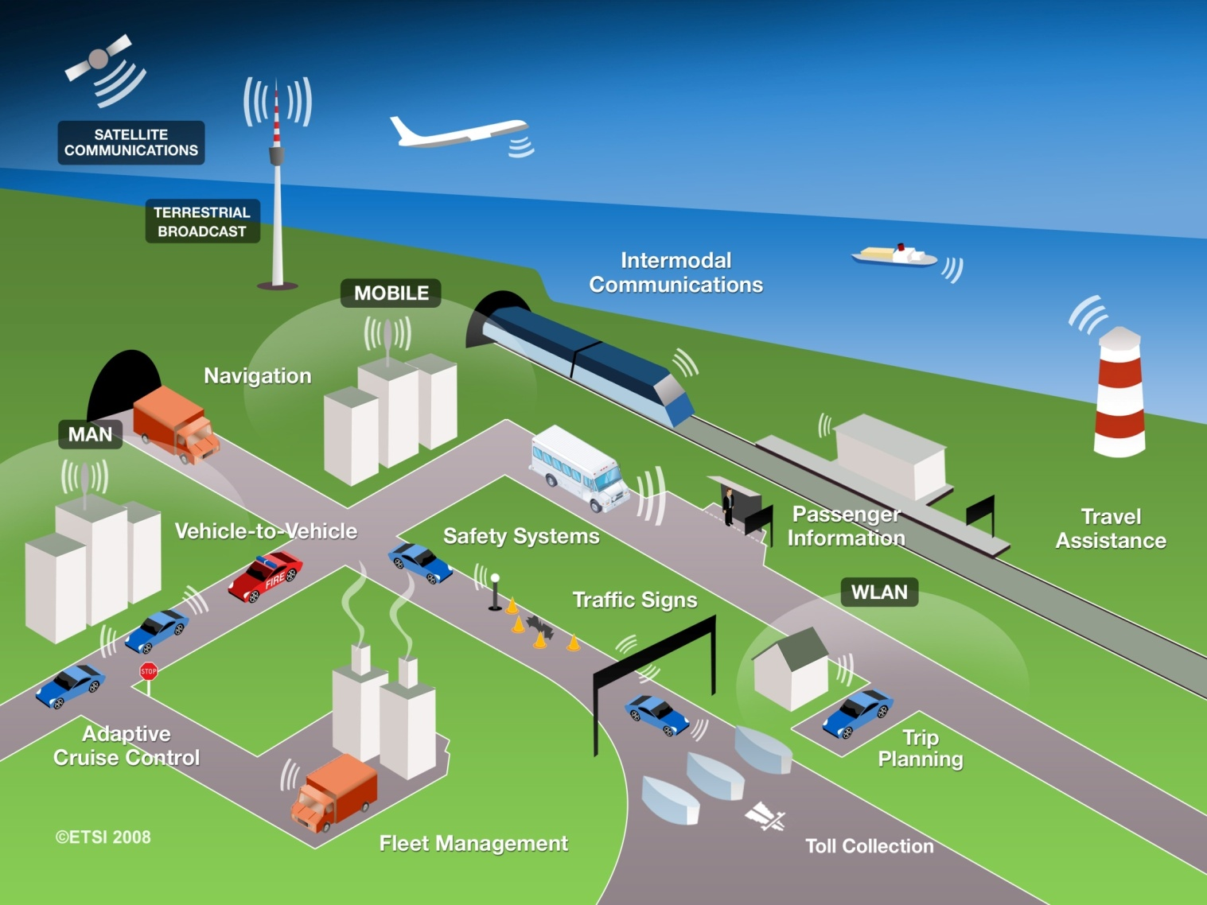
M2M Application #3 Automotive
Use Cases for
Automotive applications
ETSI TC M2M
& TC ITS cooperate
Automotive application integration in M2M platform

Slide 15
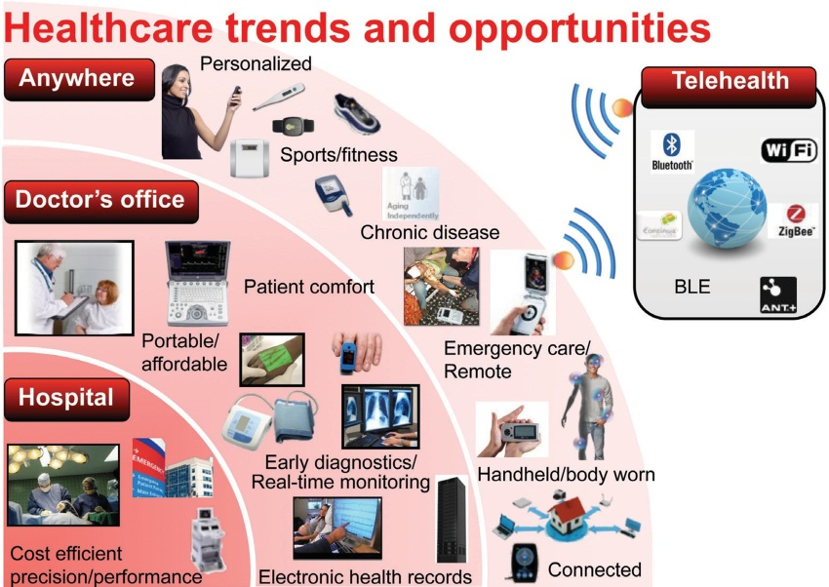

Slide 16
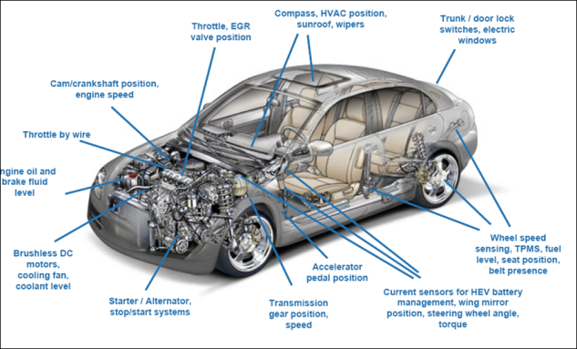

Slide 17

The sensorization of our world will effect everything

Slide 18
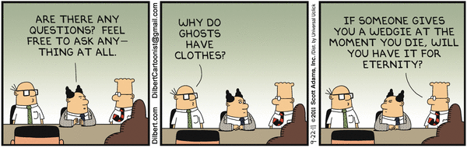
Ask Questions!

